Slide 1
COMPARATIVE STUDY TO SOLVE TEXT CATEGORIZATION
CES Data SCIENCE 2017-2018
Jacques DoaN huu

Slide 2
PROJECT MOTIVATION
DEEP LEARning OVERTAKES CLASSICAL TECHNIQUES in nLP domain
comparE Deep learning vs classical techniques to tackLe a REaL LIFE NLP Problem
Model accuracy
Model interpretability
TOOLING
SUSTAINABILITY
POSOS startup data challenge
Categorize TEXTS RELATED TO QUEStion on DRUG INTO 51 CLASSES
Few samples, MANY MISSPELLINGS, familiar writing style, drug specific vocabulary

Slide 3
WORKBENCH ENvironment
Jupyter / python as core environment
Python packages
Matplotlib / numpy / pandas
Ntlk / pyspellschecker
Sklearn / xgboost-GPU
Keras / tensorflow-GPU
Resources
French Fasttext model
Ansm drug repository
Hardware
Macbook pro > 32-CORE PC > AWS GPU INSTance > PC GAMER (GTX 1050 GPU)

Slide 4
Data exploration
understanding data structure helps to define the OPTIMAL learning procedure

Slide 5
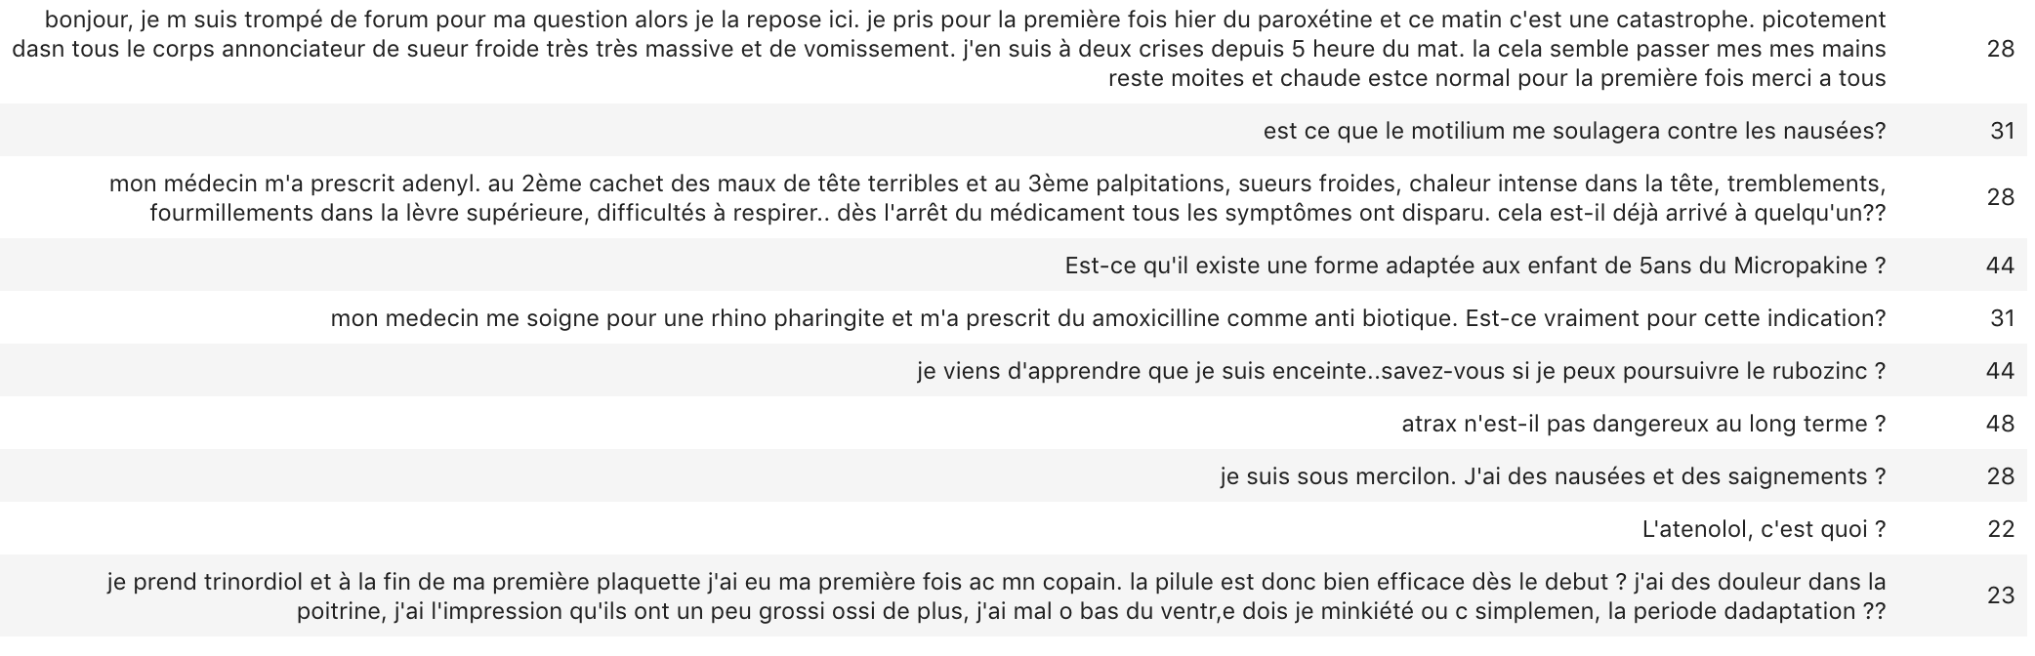
Text samples

Slide 6
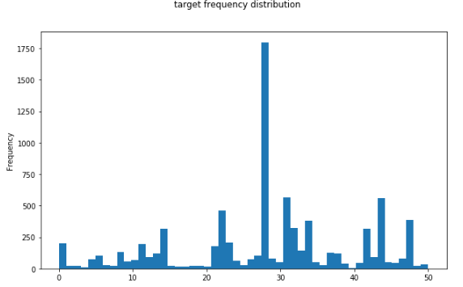
TARGET ANALYSIS
Imbalanced target distribution (51 classes)
High Standard deviation : 274
Median is under 100 samples (really short)
8000 SAMPLES for training
HOLDOUT for validation/TEST makes it shorter
Anonymized labels (1-51)
Make manual classification trickiest

Slide 7
LABEL meaning/TOPIC EXTRACTION
Manual guess on Label semantic
1st mode : drug adverse effects
2d mode : drug-disease indication/efficiency
Automatic guess with Non-negative Matrix factorization
Each topic is characterized by an ordered set of components (words)
Good matching between extracted topics and manual guess
Topic #1 matches 1st mode
TOPIC components are USED later AS FEATURE

Slide 8
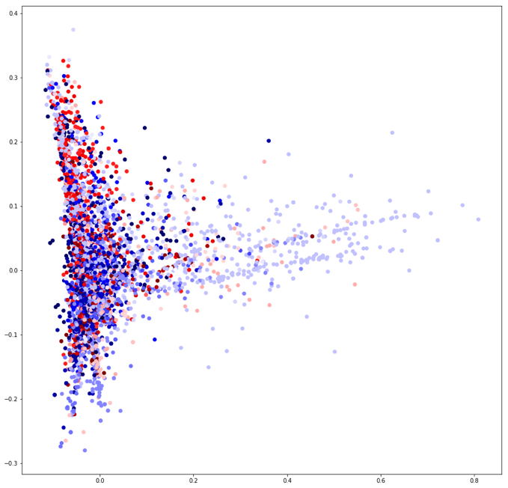
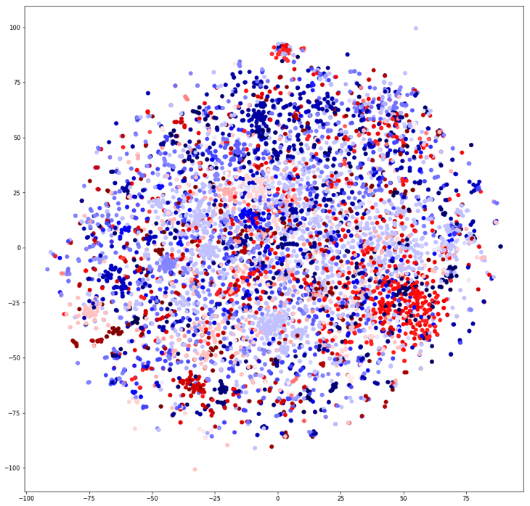
FEATURE SPACE DISTRIBUTION
2D features distribution visualization provides good hintS on classification task difficulty
USE T-SNE and PCA as dimension reduction
Per label clusters are not obviously separable
Simple bag of words representation is not enough
A more suitable rePresentation space to improve classification separability is required

Slide 9
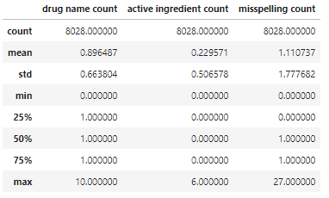
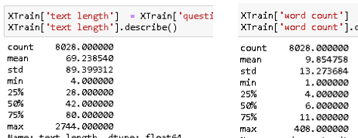

TEXT ANATOMY
Some statistics on train text corpus
Short text (word count mean = 10, high variance)
Significant misspelling estimated rate (10%)
Multi-sentence document is mainly built in 2 phases
Several sentenceS to explicit the situation/Context
Out of context question sentence

Slide 10

Named entity statistics
Drug product name entity is mostly present
Ingredient name entity is poorly present
Among gold standard entity, time entity is frequent enough to be considered
Interrogative pronoun frequencies are imbalanced

Slide 11

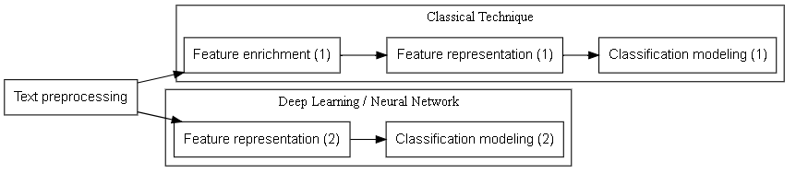
High level MODELING PIPELINE
GENErAL learning PIPELINE
Concrete learning pipeline implementationS

Slide 12
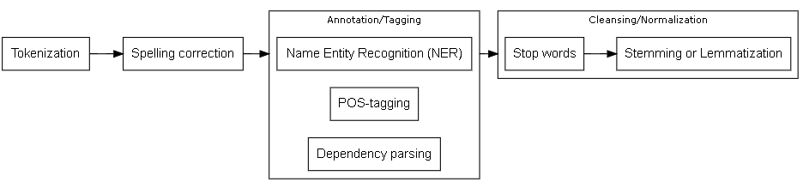
TEXT PREPROCESSING
General text preprocessing
In practice, the annotation step is underexploited on this case study

Slide 13
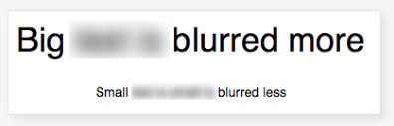
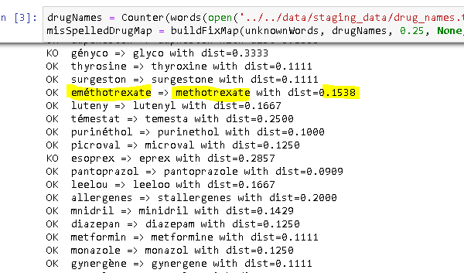
spelling correction
MisSpelled word blurs sentence meaning
Out of vocabulary words are considered as misspelled
Use fasttext vocabulary as reference
USE custom drug/ingredient vocabulary as reference too
Extracted from ANSM repository
Custom python code to find closest word from levenshtein distance point of view
583 unfixed words over Initial 2108 unknown words

Slide 14
TEXT ANNOTATION/TAGGING
Named entity recognition
Custom regular expressions (gold standard : time, interrogative pronoun, ….)
Domain based recognition of drug product and ingredient entities (ansm vocabulary)
Pos tagging
Not used, text context is supposed to be captured by sequence modeling
Dependency parsing
Not used, text context is supposed to be captured by sequence modeling
In general, french language is badly supported by NLP packages making TRICKY to LEVERAGE ABOVE ANNOTATIONS

Slide 15
Text cleansing / normalization
Vocabulary space size must to be reduced to make text workable for machine
Stopwords are applied to remove irrelevant/frequent words
Stemming is applied to collapse morphological variants into their root
It eliminates irrelevant semantic distance on features
Stemming is INcompatible with word embedding whose vocabulary is not stemmed

Slide 16

CLASSICAL TECHNIQUES
ALL TECHNIQUES which are not relying on neural network
SVM,Gradient boosting, Hidden markov model, …

Slide 17
Modeling elaboration
Hidden markov model As sequence modeling is FULLY suitable for NLP
BUT Few python implementationS (hmms 0.1) and this method is difficult to exploit
Compensate sequence modeling discarding with manual feature engineering
Count and distance based statistics on KEY named entities
topic likelihood features
Select xgboost as the best multi-purpose Classifier

Slide 18
Text vectorization
TF-IDF (Term frequency inverse document frequency)
Document is represented as a numerical vector in word space
Word order (context) is lost
Word co-occurrence is caught to explain target
PCA (principal component analysis) as fast linear dimension reduction
300 dimensional output space similarly to fasttext model

Slide 19
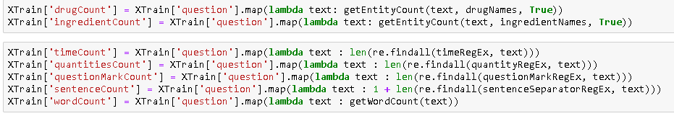
Text Statistics AS eXTRA FEATURE
Basic Statistics on text anatomy
Word count, sentence count, …
statistics on named entities
Named entities are identified by its domain or thanks to custom regular expressions
Count based statistics (drug product name, time, quantity, …)
distant based statistics (word distance between 2 entities)
It captures the relative word order on key entities

Slide 20
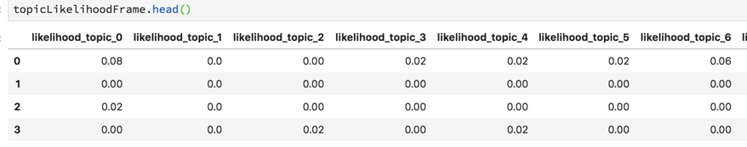
Topic likelihood feature
Extract 50 topics with nmf algorithm
Expect topic matches label with HIGH correlation
Compute the probability that a text is related to the topic as
P (TOPIC |TEXT) = intersect_count(WORDS(TEXT), topic_components)/ Count (topic_components)

Slide 21
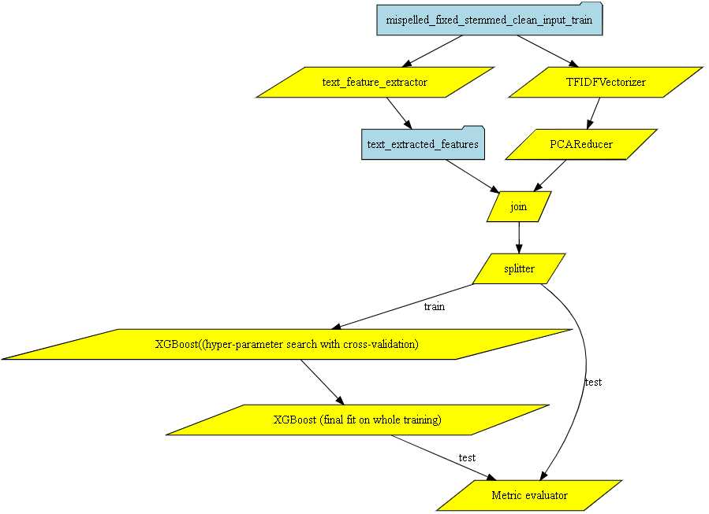
Classical method pipeline overview

Slide 22
hyper-parameters SEARCH
Focus on SMALL SUBSET OF instrumental hyper parameters
max_depth
min_child_weight
n_estimators
learning_rate (eta)
They are ‘grid-searched’ with Cross validated dataset to find the optimal values
Even with gPU acceleration, grid search was very slow
Once hyper-parameters are fixed, fit the model on the whole training set

Slide 23
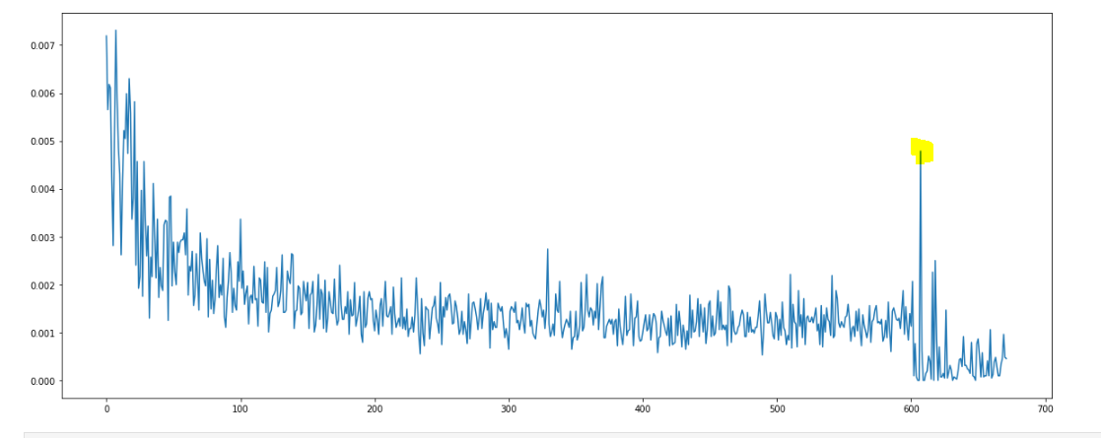
Performance resultS
Poor accuracy on test SET
micro F1-score macro F1-score support
0.63 0.44 1205
Micro Score is more meaningful for OUR CASE STUDY with label imbalance
EXTRA features (at the tail) have unexpectedly low explanatory importance

Slide 24
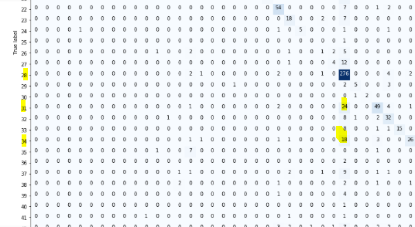
Context ambiguity
Confusion matrix shows high confusion between label 28 and 31
Label 28: drug-disease contraindication
Label 31: drug-disease indication
It confirms that learner doesn’t grasp context (in particular the negation here) and operates only on word co-occurrence

Slide 25
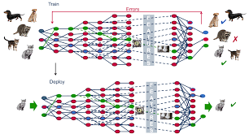
DEEP LEARNING
All-In-one modeling inspired from brain architecture

Slide 26
NN Modeling elaboration
NN (Neural network) is capable to model sequence
Document is represented as a M-gram structure of words (padding)
Word is itself vectorized into a reduced K-dimensional numerical space
Word embedding is implemented in a neural network fashion
N Documents are represented as a sparse NxKxM numerical matrix
No stemming is applied (incompatible with word embedding)
Different nn architectures are tested

Slide 27
Word embedding
Word embedding projects words into numerical space where distance is semantic aware
Words sharing same context in text are closer in such space
It’s a powerful NLP vectorizer which learns on text corpora
Domain specific corpus (drug domain in our case study)
Keras provides a embedding layer wrapper
General corpora (wikipediA, …)
Fasttext model is available in french language

Slide 28
Out of vocabulary handling
Word embedding is limited to the vocabulary it learns from text corpora
Common Out of vocabulary handling is to generate random vector
One novel alternative is to generate a vector close to the vector representing the hypernym/entity of the unknown word plus a small stochastic variation
Entity is usually part of the embedding vocabulary
Small variation is based on random generator taking the word as seed
This is typically appLicable TO drug product name and ingredient
XANAX -> vector(‘médicament’) + small_random_vector(SEED=Xanax)

Slide 29
Architecture candidates
Dense neural network (dnn)
Ad-hoc word embedding
Non sequenCE learning
Recurrent neural network (RNN/LSTM)
General vocabulary embedding + drug domain extension (OOV handling)
Native sequence learning
Convolutional neural network (CNN)
General vocabulary embedding + drug domain extension (OOV handling)
2 VARIANTS : SEQUENTAL Or parallel ConvolutionaL layers
sequence learning with 1D sliding window convolution

Slide 30
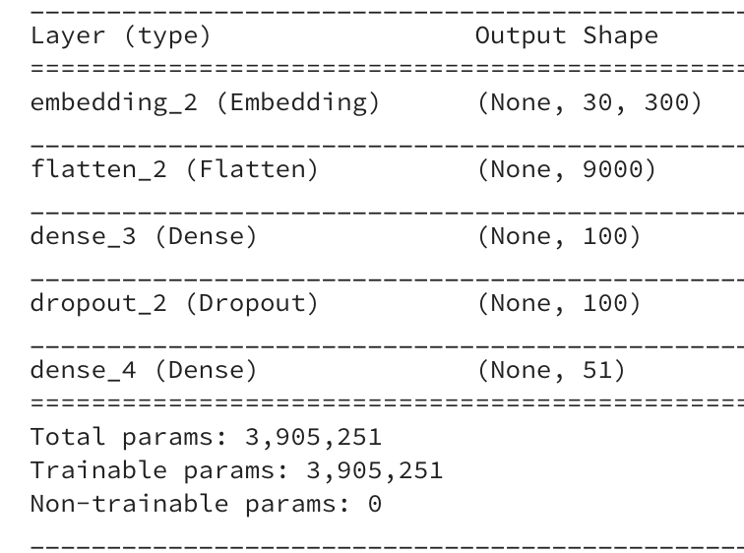
Dense neural network
Custom embedding is built upon training set
Small corpus but task domain specific
2 dense layers
Last one is activated with softmax to produce class probabilities
1 dropout layer aimed to regularize NN
Use as performance toy baseline

Slide 31
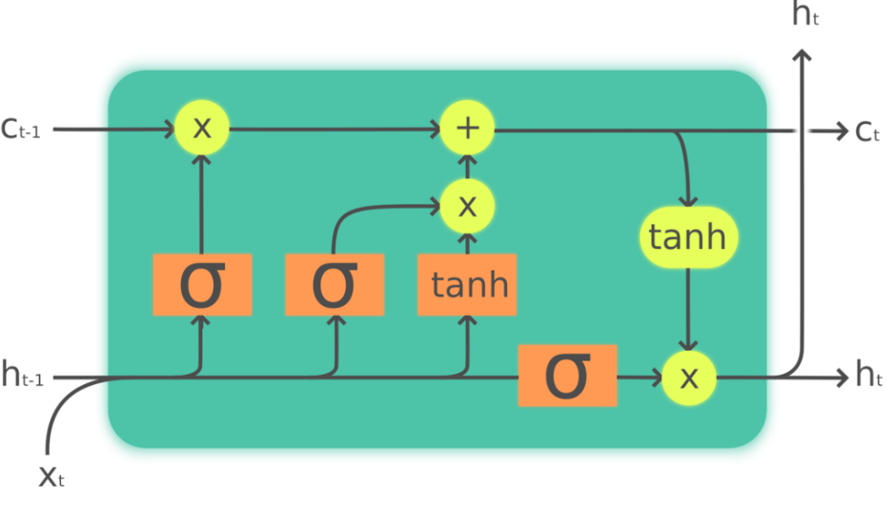
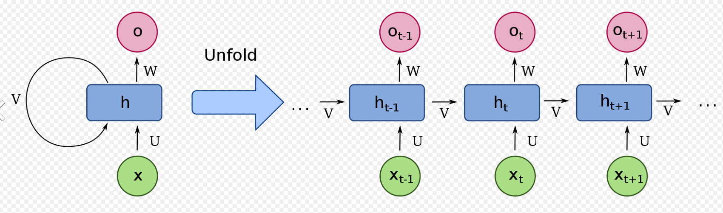
RNN architecture with LSTM unit
Support natively sequence learning
LSTM unit enables to deal with long tail dependency
BIDIRECTIONAL WRAPPER captures in additional backward dependency
CUDNNLSTM keras wrapper is fast ligthning
Neural network is composed of
General vocabularY embedding layer
LSTM layer
Dense layer
Probability Normalization layer (softmax)
LSTM unit
Recurrent Neural Network

Slide 32
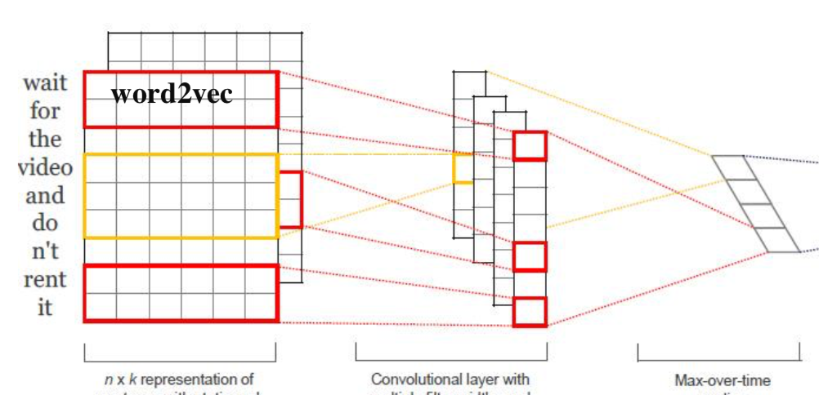
CNN architecture
Convolute word sequence with 1D sliding window to catch local context
2 architecturE variants
Parallel CNN layers
Sequential CNN Layers
Neural network is composed of
General vocabulary embedding layer
CNN layers
Dense layer
Probability Normalization layer (softmax)

Slide 33
Architecture / Hyper-parameters search
This is the major DOWNside of the NN approach
Finding a good architecture is HARD and somehow empirical
Number of layers? Dropout required? Parallel or sequential Layers?
Many non intuitive hyper parameters to setup
CNN number of filters, CNN kernel size, drop out ratio, recurrent constaint,…
Beginner BETS on non optimal default parameters and tests arbitrarily some values
Grid search and cross validation are not supported natively
NN train is moreover very slow without high end GPU making grid search void
BOOSTRAP from «magic » numbers unveiled in PAPERS tackling TEXT classification
References are provided in appendix
It’s the counterpart of the NN versatility and learning performance

Slide 34
NN Tuning
Sequence MAX LENGTH
search RANGE : 15, 20, 25, 30 (word count mean: 9, std deviation: 13)
LTSM
Backward or Bidirectional dependency
PARALLEL CNN (refer to REF1& REF3)
3 Filter sizES : 3, 4, 5 (3 parallel convolutional branches)
3 MAX POOLING SIZES : 1
Add DROPOUT layers even if REF3 asserts marginal gain (drop ratio: 40%)
SEQUential CNN (refer to REF2 & REF3)
3 Filter SIZES : 3, 4, 5 (sequential)
3 MAX POOLING SIZES : (1, 2, 5), (1,2, 5) , (1, 4, 10)
Add DROPOUT layers even if REF3 asserts marginal gain (drop ratio: 40%)

Slide 35
Performance results
Early stopping is enable to avoid overfitting
Performance on TEST is not conclusive
ParalleL cNN and LSTM deliver relatively the best performance
Sequential CNN is suprisingly below
GENERAL low PERFORMANCE is likely due to both data shortage and inexperience on NN tuning
Architecture | Micro F1 score | Macro F1 score
DNN | 60% | 40%
RNN/LSTM (no bidirectional) | 65% | 44%
Parallel CNN | 67% | 48%
Sequential CNN | 61% | 45,7%

Slide 36
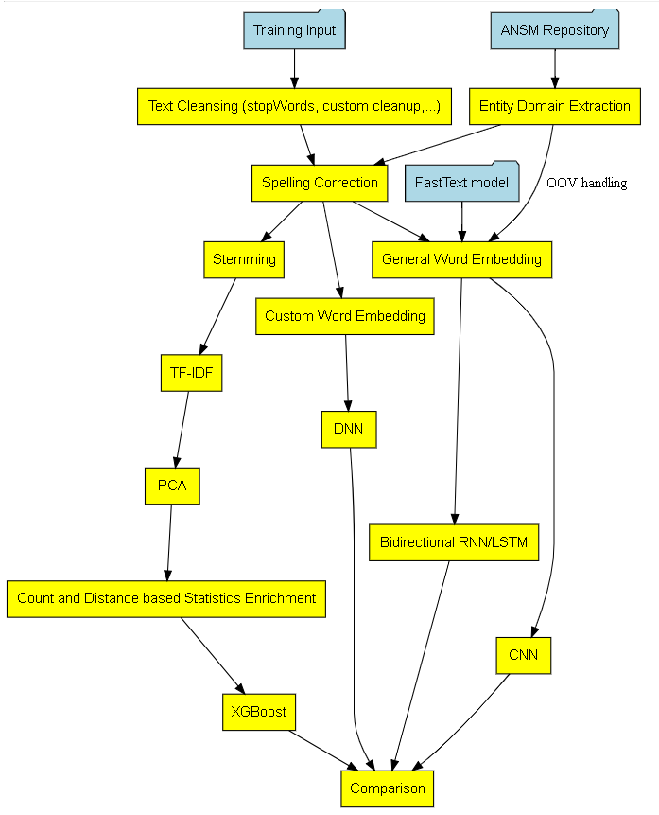
Modeling comparison

Slide 37
Model interpretability
DEEP LEARNING gives in general outstanding accuracy but it’s lacking in the field of model interpretability
No native support of variable importance (use exogeneous estimator like LIME)
No individual contributionS at prediction time
Non intuitive hyper parameters (difficult to understand its effect to the performance)
Sklearn/XgBOOST offers a better support of interpertability (variable importance and individual contribution)
This is the well-known DILEMMA between accuracy and interpretability

Slide 38
TOOLING
Sklearn is much more a powerful but disparate toolkit perfectly integrated with other packages (matplotlib, xgboost, …)
It supports nicely standard methodologies (cross validation, grid search, …)
It runs on regular machine
In contrast, deep learning is an one-stop-shop learning framework
Keras abstract layer simplifies dramatically the network construction
Tensorboard provides useful visualization but features are still limited
It requires GPU acceleration

Slide 39
substainability
Xgboost/Sklearn and Tensforflow/Keras are supported by a strong community
Nevertheless, Research on Deep learning seems to be more active
What is counting finally is the capacity to provide good performance in an acceptable execution time on your particular prediction TASK

Slide 40
STATE OF ART
This is an ACADEMIC Comparative study isolating techniques and their variants
Objective is to highlight their respective strength and weakness
In real life, winning practiceS advocate to
Try several techniques and keep the one delivering the best performance
Combine them
Rnn and cnn architectures
Word embedding + manual feature extraction

Slide 41
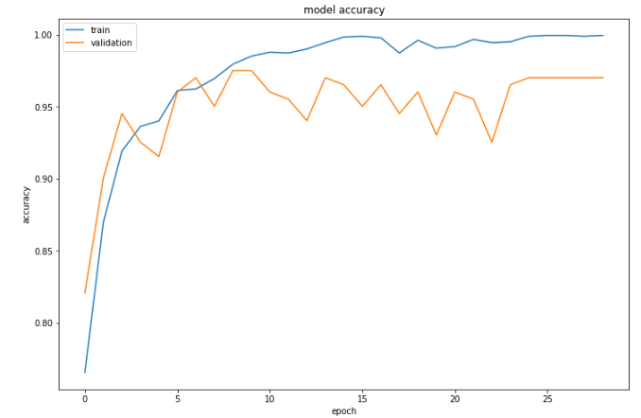
Too Few Samples/Too Many Target Effects
Multiclass learning is tricky with imbalanced/numerous labels and low samples
Performance in consequent is low (67% at BEST)
In better condition (KEEP the 2 most frequent classes to predict) with LSTM
Learning curve looks much more appealing
Micro F1-score on test reaches 92% with LSTM!
Learner needs sufficient data with FAIRLY balanced distribution

Slide 42
takeaways
Non conclusive performance results (67% micro F1-score at best)
Extracting sense from natural language is hard ( especially with familiar french !)
Too few samples and too many target classes
Disappointing relative gain obtained with sequence learning (CNN or LSTM)
DL is extremely flexible, highLY efficient but tricky to tune
classical Technique is more easy to setup but exhibits some performance limitations
rewarding Return of experience on key Data science methodology
DATA Exploration and analysis
Data preparation (feature representation)
Modeling/architecture selection + Hyper parameters search
Result analysis and improvement loop-back

Slide 43
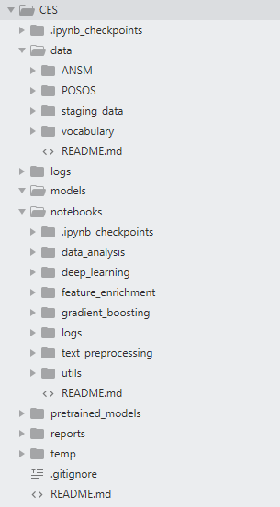
appendix
POSOS DATA CHALLENGE DESCRIBED AT
https://challengedata.ens.fr/fr/challenge/33/predisez_la_reponse_attendue.html
Runnable notebooks available at
https://github.com/jhuu32/CES
BLOG/PAPER REFERENcES
Convolutional Neural Networks for Sentence Classification (REF1)
https://arxiv.org/abs/1408.5882
TEXT CLASSIFICATION WITH sequentiaL CNN GITHUB PROJECT (REF2)
https://richliao.github.io/supervised/classification/2016/11/26/textclassifier-convolutional/
Sensitivity Analysis of Convolutional Neural Networks for Sentence Classification (REF3)
https://arxiv.org/abs/1510.03820

Slide 44
One last thing
VERY LAST NN EXPERIMENT with RNN, GRU and attention architecture
GRU is a more recent and simple unit than LSTM
Micro F1 score = 68,5%
https://github.com/jhuu32/CES/blob/master/notebooks/deep_learning/deep_learning_GRU_attention_with_fasttext_embedding.ipynb
Modeling improvement is never ending !

